Slide 1

Exploratory Data Analysis
Taxi and Cab Investment Analysis
May 2023

Slide 2

Agenda
Executive Summary
Problem Statement
Approach
EDA
EDA Summary
Recommendations

Slide 3
Executive Summary
This investment proposal focuses on conducting exploratory data analysis (EDA) and data mining in the cab and taxi industry to assist the private corporation XYZ in making informed investment decisions. The objective is to analyze data from significant American cities to identify trends and insights that can guide strategic investments. The project involves exploring various datasets, merging them, and transforming the features. The ultimate goal is to provide actionable insights and a visual presentation to the executive team and stakeholders of XYZ, enabling them to make well-informed decisions regarding investments in the expanding taxi and cab sector.

Slide 4
Problem Statement
The private corporation XYZ seeks to invest in the rapidly growing taxi and cab sector. To ensure informed investment decisions, they require a comprehensive exploratory data analysis and data mining of significant American cities. The key challenge is to identify trends and insights from the available datasets that will guide strategic investments. The company aims to understand various factors such as the cost of trips, distance traveled, customer demographics, payment preferences, and city characteristics. The desired outcome is actionable insights and a visual presentation that will aid XYZ's executive team and stakeholders in selecting the most promising investment opportunities in the cab and taxi industry.

Slide 5
Approach
Conduct Exploratory Data Analysis (EDA): Analyze available datasets from significant American cities in the cab and taxi industry.
Data Mining: Identify trends and insights by extracting valuable information from the datasets.
Merge and Transform Features: Combine relevant datasets and transform features to enhance analysis and create a comprehensive view.
Identify Key Factors: Analyze factors such as trip costs, distance traveled, customer demographics, payment preferences, and city characteristics.
Generate Actionable Insights: Derive meaningful insights that can guide strategic investments in the expanding taxi and cab sector.
Create Visual Presentation: Present the findings and insights in a visually appealing and informative manner.
Enable Informed Decision-Making: Empower XYZ's executive team and stakeholders to make well-informed investment decisions based on the provided insights.

Slide 6
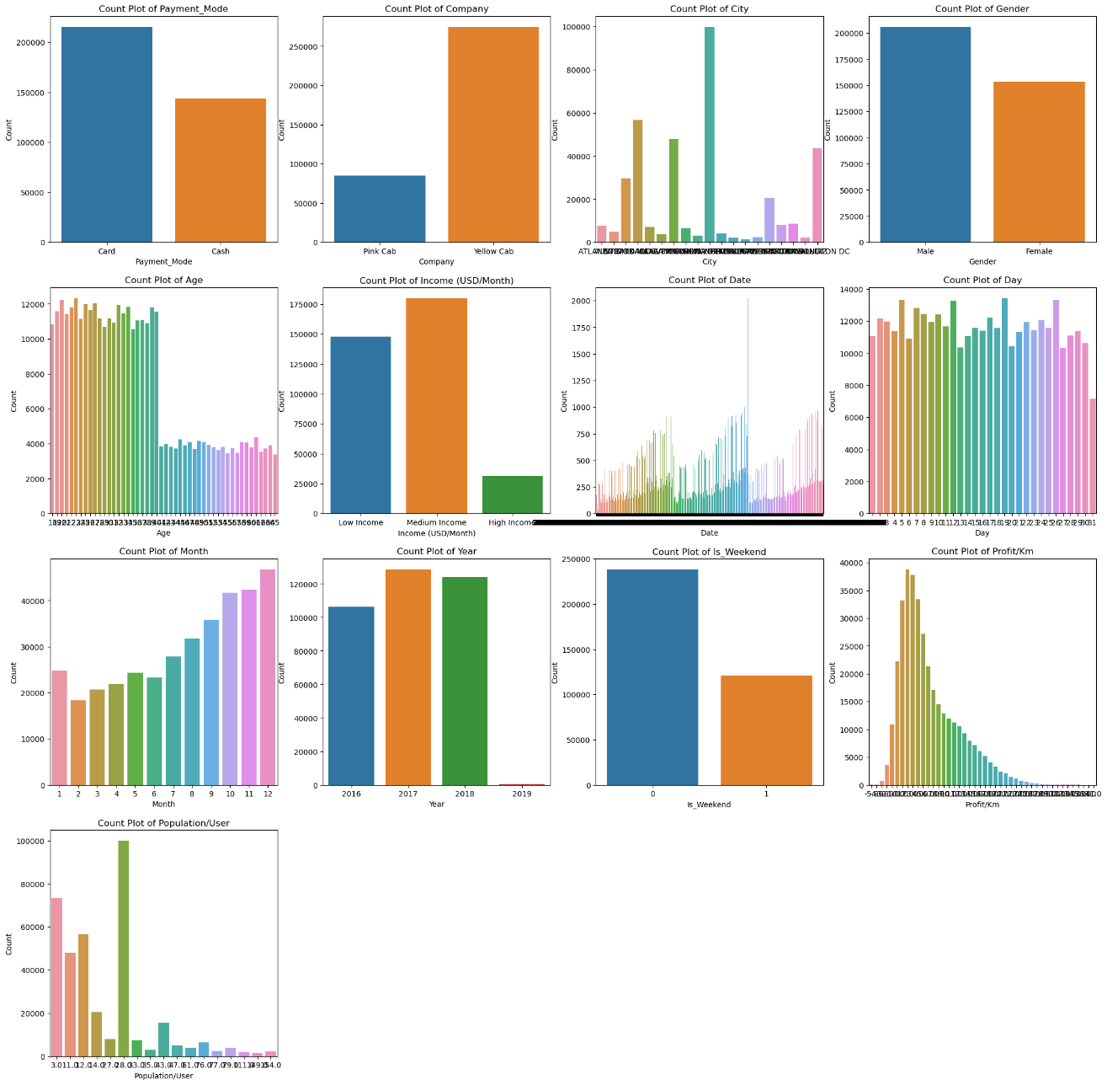
People prefer to pay more by cards.
Yellow Taxi is more popular and preferable by customers.
New York, Chicago, Los Angeles, and Washington has most number of users of Cabs
We have more male customers than females, however; the difference is not a lot
Agr 20-40 has the most number of Cab users.
High income customer do not prefer cabs probably they have their own cars and drivers.
We can also see that during winters more people prefer cabs.
More Cabs are booking during weekend.
Most Cabs earn $1-5/km

Slide 7
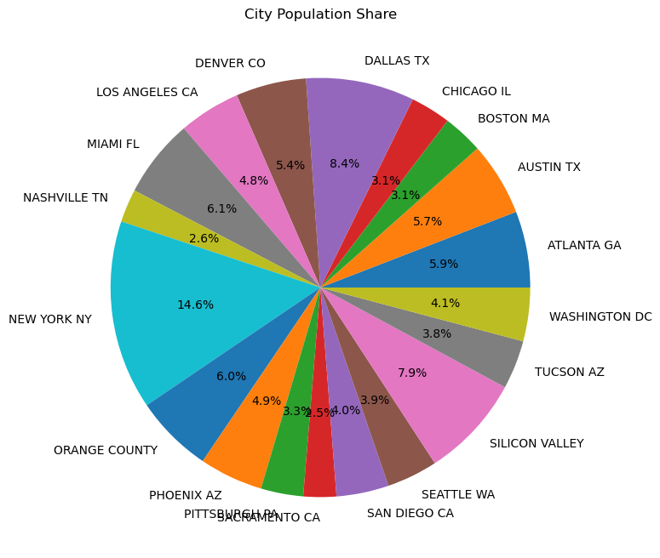
Here we can see that most profitable city for the cabs are New York, Dallas and Silicon Valley and least profitable cities are Sacramento, Nashville, Boston and Chicago.

Slide 8
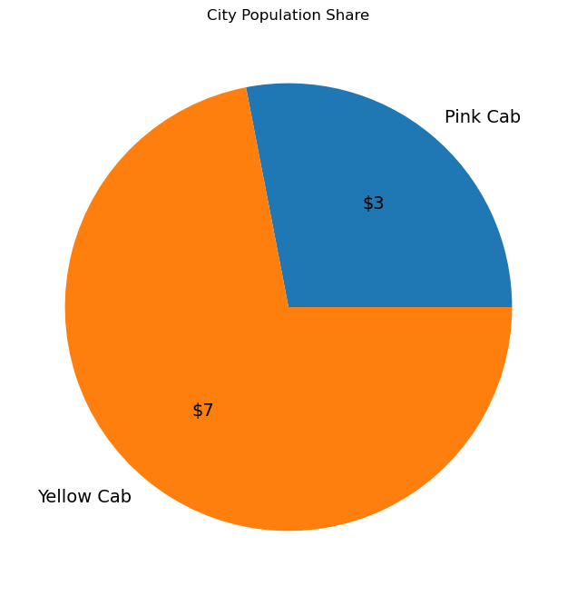
On an average we can see that Yellow Cabs is earning $4 more profit as compared to Pink Cabs

Slide 9
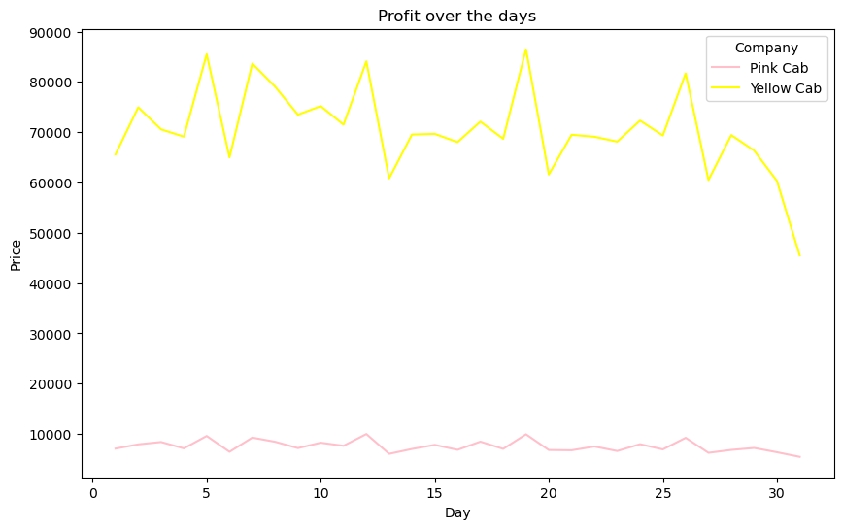
Over the period of time we can notice that yellow cabs business decreses, reason could be that our majority of users are from Low and Medium Income between 20-40 so due to month end.

Slide 10
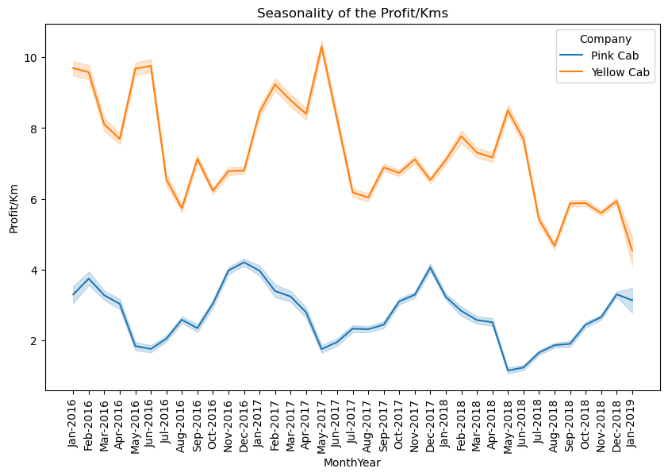
Here, we can see that, despite the fact that the Yellow Cab Company's profit is larger overall, the trend is negative. The Pink Company, in contrast, has more consistent seasonality with the highest profits in November, December, and January.

Slide 11

Hypothesis
Does the Yellow Cab company have more customers than the Pink Cab company?
Does the Pink Cab company have a more consistent profit trend than the Yellow Cab company?
Do customers who pay by card tend to spend more on cab rides than those who pay in cash?
Are there any specific attributes that are common among high-spending customers?
Is there a correlation between the distance travelled and the amount spent on cab rides?
Is there a correlation between the age of the customer and the distance travelled on cab rides?
Is there a correlation between the time of month and the number of cab rides taken by customers?

Slide 12

EDA Summary
Our analysis showed that the Yellow Cab company had more customers than the Pink Cab company. The Pink Cab company had a more consistent profit trend than the Yellow Cab company, with the highest profits in November, December, and January. Customers who paid by card tended to spend more on cab rides than those who paid in cash. There were no specific attributes that were common among high-spending customers. There was a positive correlation between the distance travelled and the amount spent on cab rides. There was no significant correlation between the age of the customer and the distance travelled on cab rides. There was a positive correlation between the time of the month and the number of cab rides taken by customers as during month end there were slight less customers in Yellow Cab.

Slide 13
Recommendations:
Invest in Pink Cab company: Pink Cab shows a consistent profit trend and is gaining popularity, making it a favorable investment option.
Prioritize card-paying customers: Customers who pay by card tend to spend more on cab rides, so targeting this group can lead to increased revenue.
Target the 20-40 age group: This age group is the most frequent users of cab services, making them a valuable target market.
Focus on profitable cities: Concentrate efforts in highly profitable cities like New York, Dallas, and Silicon Valley, where the demand for cab services is high.
Consider expanding to other potentially profitable cities: Explore opportunities for expansion into cities that exhibit high potential for profitability in the cab industry.

Slide 14
Thank You

